Slide 1
MACHINE LEARNING APPROACH FOR DETECTING GENE-DISEASE ASSOCIATION
Md. Al-Amin
Md. Shafayat Jamil
Arittra Das
Swarnajit Saha
190104001
190104022
190104083
190104086
Supervised By:
Dr. S.M.A. Al-Mamun
Professor, CSE
Ahsanullah University of Science and Technology

Slide 2
Motivation
Find out the approach to to discover new treatments for diseases.
To bring out improvements in the fields of medicine.
To improve the health and well-being of people all across the world.
To understand the underlying biological mechanisms of a disease.
Early detection to improve treatment outcomes.

Slide 3
Objective
01
02
03
04
Identify complex relationships of genes and diseases
Find more efficient and cost-effective way
Find potential to improve the diagnosis, treatment, and prevention of diseases.
Predict unknown gene associated with disease

Slide 4
Machine Learning
Analyze large datasets of genetic and clinical data to identify patterns
Provide a better knowledge of the mechanisms by which genes create diseases.

Slide 5
Machine Learning Models
Decision Tree Regression
Random Forest
Linear Regression
Support Vector Machine
Gradient Boosting

Slide 6
Gene
Located on Chromosomes.
Physical and functional unit of heredity.
Contains the instructions for an organism.

Slide 7
Disease
Abnormal Condition
Physical Changes
Permanent or Temporary
Genetic and non-genetic sources

Slide 8
Relation Between Gene & Disease
Gene exist in every cell
Modifications to genes can result in diseases
Examples Cystic fibrosis, Parkinson’s, Autism spectrum disorders, Thalassemia, Hemophilia.

Slide 9
Genetic Modification
Mutations
Recombination
Epigenetic modifications
Natural selection

Slide 10
Our Goal
Find the relationship between Gene and Disease.
Predict the relationship score.
Use machine learning.
Predict the score even if the relationship is not in literature.

Slide 11
Workflow
Data Collection
Feature Selection
Data Pre Processing
Dataset
MAE
Trained Model
Machine Learning Model
Training
80%
Data Partitioning
MSE
Testing & Evaluation
Testing
(20%)
RMSE
R^2

Slide 12
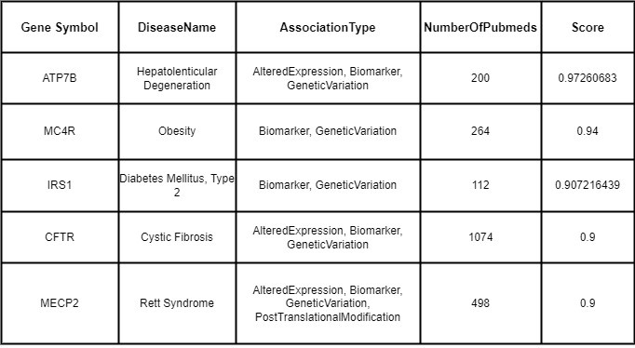
Collected Dataset
Collected form DisGeNET.
Total 26523 combinations of gene-disease relations.
Table 1 : Collected Dataset

Slide 13
Feature Description
Gene Symbol
Disease Name
Association Type
Number of Pubmeds
Score

Slide 14
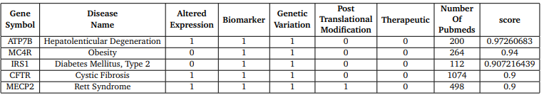
Data Pre Processing
Step 1:
Need separation of the association type.
Defined by 0/1.
Table 2: Separation of association Type.

Slide 15
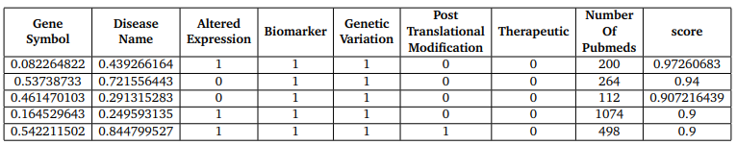
Data Pre Processing(Cont.)
Conversion of gene symbol and disease name from string to numerical Value.
Table 3: Final Input.

Slide 16
Machine Learning Libraries
Numpy
Sklearn
Pandas

Slide 17
Implementation
Converted “Gene symbols” and “DiseaseName” numerical form by LabelEncoder.
Use MinmaxScaler object to normalise the values to the range
0 to 1.
By SimpleImputer object we imputed missing values.

Slide 18
Result
Model | Mean Squared Error (MSE) | R^2 | Regression Score
Decision tree regression | 0.3 | 0.37 | 0.68
Linear regression | 0.29 | 0.23 | 0.60

Slide 19
Result Evaluation
The result is not up to the mark.
Can be improved.

Slide 20
Conclusion & Future Work
Implemented some models to predict the score
Study several relevant papers
Improve the accuracy
Identify the unknown gene associated with disease

Slide 21
References
“Disgenet.” https://www.disgenet.org/. Accessed on May 12, 2023.
“National human genome research institute.” https://www.genome.gov/
about-genomics/fact-sheets/A-Brief-Guide-to-Genomics.
Accessed on May 12, 2023.
“Human genetic variation.” https://www.ebi.ac.uk/training/
online/courses/human-genetic-variation-introduction/
what-is-genetic-variation/. Accessed on May 12, 2023.
“Javatpoint.” https://www.javatpoint.com/
types-of-machine-learning. Accessed on May 12, 2023.

Slide 22
THANK YOU!

